Slide 1
Learn JavaScript with fun, build an UFO hunter game Game engine plan

Slide 2
Animation on Canvas
Game engine
draw
clear
draw
clear
draw
clear
draw
clear
draw
draw : drawImage()
clear : clearRect()
Canvas

Slide 3
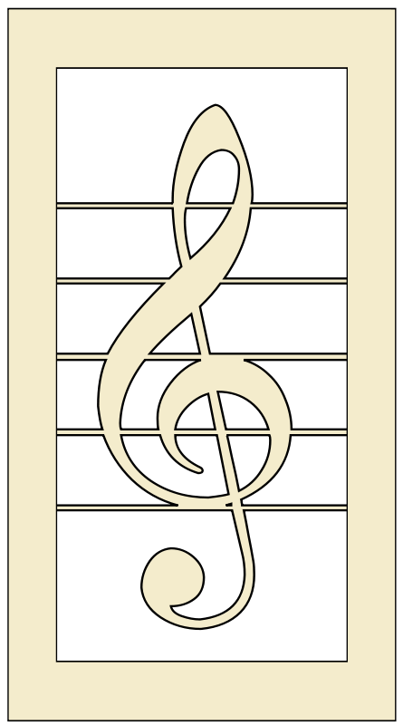
Game engine plan
objects
main
sounds
positionOpening
positionTransfer
positionInGame
positionPause
positionGameOver
Canvas

